Slide 1
Interacting with Computers on Networks
How to discover devices on a network
What to do once you find them
Notes:
This is a very broad topic
Feel free to ask questions at any point if I forget to make something clear

Slide 2
What is a network?
Highest level: ISPs
P2P vs client/server
Subnets into subnets into subnets
What is a subnet?
routers
192.168/10/172
192.168.x.x
10.x.x.x
172.16-31.x.x
Each router is only aware of its direct connections
IPv4/IPv6
Notes:
Gauge of how much you guys know
Lots of things in security are about understanding things at a very base level

Slide 3
Some common commands
Tracert/traceroute
Ping
Ipconfig/ifconfig
Whois
DNS Lookups

Slide 4
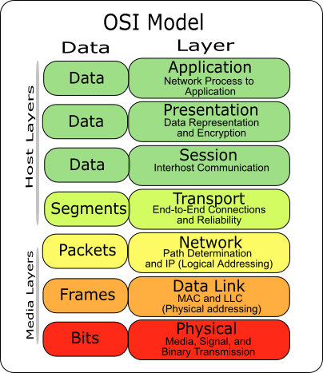
How do you communicate over a network?
Notes:
You can talk for hours on all the intricacies in each of the layers on the OSI model
A way of classifying the level of abstraction you are dealing with on a network

Slide 5
How do you communicate over a network?
Layers 3/4
Why they are important
Layer 4
TCP vs UDP
ports
Notes:
Layers 3 and 4 are what most of your focus in security will be
Port abstraction
Port forwarding, “only aware of its direct connections”

Slide 6
Sidenote: common TCP ports
20: FTP
22: SSH
80: HTTP
443: HTTPS
1024+: non-system ports

Slide 7
What is a packet?
Layer 3 data abstraction
Provides a data structure for different types of protocols
A set of data fields
Notes:
Wireshark will be covered 9/16

Slide 8
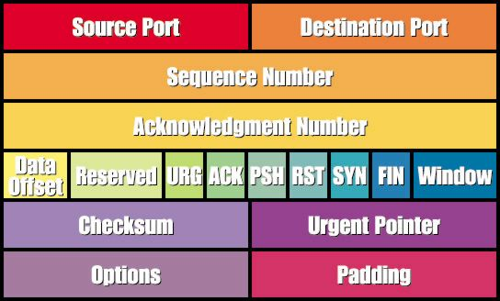
TCP Packet Structure
Notes:
Note: TCP/IP – TCP packets are sent “on top of” IP packets

Slide 9
What is a firewall?
A means of restricting the flow of packets to and from a subnet
stateful vs stateless
Iptables
examples
Notes:
Note that almost all networking hardware – firewalls, routers, etc. are all running some modified linux distro

Slide 10
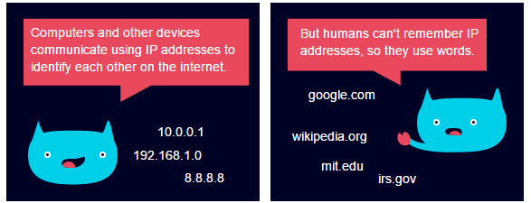
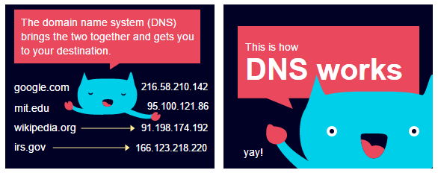
What is DNS?
Associate IPs with URLs
Chain of authority
ARP
https://howdns.works/ep1/
Notes:
Example through traceroute/ping
ARP & DNS often work together to locate the destination of traffic
ARP poisoning – brief overview

Slide 11
INTERACTING WITH A NETWORK
Netcat
Scapy
Nmap

Slide 12
Netcat
Low level tcp interface
Connects to a port & sends and recieves plaintext
Communicates with proper protocol
Very useful for low level analysis
Common tool for ctfs
Nc 8.8.8.8 23
Notes:
“swiss army knife of networking” – Phillip Mak
Nc 45.55.32.24 9001
__import__(“os”).system(“/bin/bash”)

Slide 13
Scapy
Even lower level network interface
Runs as a module in Python
Allows you to build packets field by field
Useful for some challenges involving lower level exploits
examples

Slide 14
Nmap
One of the best discovery tools
Intelligent port scanning
Different types of scans
Notes:
​__import__(“os”).system(“/bin/bash”)

Slide 15
NMAP – Scan Types
TCP Connect scan - This type of scan is the most reliable, although it is also the most detectable. It is easily logged and detected because a full connection is established. Open ports reply with a SYN/ACK, whereas closed ports respond with an RST/ACK. Uses standard connect() system call.
TCP SYN scan - This type of scan is known as half open because a full TCP three-way connection is not established. This type of scan was originally developed to be stealthy and evade IDS systems although most now detect it. Open ports reply with a SYN/ACK, whereas closed ports respond with a RST/ACK.
TCP FIN scan - This type of scan sends a FIN packet to the target port. Closed ports should send back an RST. This technique is usually effective only on UNIX devices.
TCP NULL scan - a NULL scan sends a packet with no flags set. If the OS has implemented TCP per RFC 793, closed ports will return an RST.
TCP ACK scan - This scan attempts to determine firewall access control list (ACL) rule sets or identify if stateless inspection is being used. If an ICMP destination unreachable, communication administrative prohibited message is returned, the port is considered to be filtered.
Version Scanning & OS scan – tries to determine the version number of the program listening on the port\

Slide 16
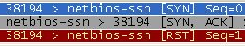


TCP SYN Scan
Client SYN → Server
Client ← SYN/ACK Server
Client RST→ Server
The server is ready but the client never completes the handshake.
Somewhat stealthy since session handshake is not completed which keeps it out of some log files
Closed
Open
Filtered
Notes:
Explain tcp handshake
SYN -> SYN/ACK,RST and ACK -> RST, the port is unfiltered by any firewall type
SYN -> SYN/ACK, ACK -> nothing, the port is statefully filtered.
SYN -> no SYN/ACK and no RST, ACK -> RST, the port is statefully filtered
When neither SYN nor ACK generates any response, the port is blocked by a specific firewall rule
MENTION SYN FLOODS

Slide 17
NMAP – ACK Scanning
Some firewalls may allow for outgoing SYN connections and their incoming responses with the ACK bit set.
Stateful firewalls maintain the state of the SYN and ACK packets and will only allow an ACK inbound if there is an outstanding SYN packet.
Can be useful for network mapping

Slide 18
NMAP – FTP Bounce Scan
RFC 959 defines a “feature” in FTP which allows for FTP proxy connections.
Essentially I can connect to a FTP and request the server to send a file to a client.
This should be disabled on properly configured FTP servers.
Can be used on misconfigured FTP server to bounce a scan off the server thereby hiding the attackers location.
Use “port” command to try and list directory. If target is listening on the port it will respond with a 150 or 226 response
If the port is not listening or closed it will respond with “425 Can't build data connection: Connection refused.”
Useful to get around firewalls if firewall allows connection to FTP server.

Slide 19
IDLE Scan (Hide the Scan Source)
Normal port scans send TCP SYN packets to the target and wait for a SYN-ACK
Problem with this is that the attacker is easily identified
If the attacker Spoofs their source IP address then the attacker doesn't’t receive the results of the scan.
Use the IP Identification Field of the IP Header.
Normally used to group fragments of IP packets together
Most operating systems increment the IP Ident field by one for each packet sent.

Slide 20
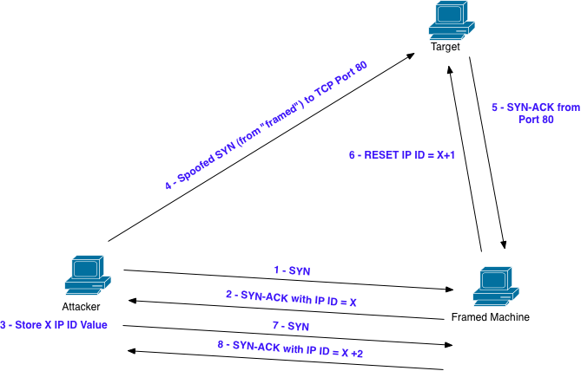
IDLE Scan (cont)
Notes:
http://nmap.org/book/idlescan.html

Slide 21
Useful NMAP Command with OS Fingerprinting
nmap -sV -O -sC --top-ports 100 -T4 -oA [file] [address]
nmap -sV -O -sC --top-ports 100 -T4 -oA out.txt 10.1.1.0/24
-sS -Syn scan
-sT -Connect scan
-sV -Probe open ports to determine service-/version info
-O -Enable OS detection
-sC -Enable Script scanning
--top-ports -Only scan “popular ports”
-T4 -Sets template for fast scans (0 slow – 5 fast)
-oA -Output file
https://nmap.org/book/man-port-scanning-techniques.html
Notes:
Nmap has a ton of port scanning options; look at man pages

Slide 22
USE THE MAN PAGES

Slide 23
Wireless?

Slide 24
Q&A

